Slide 1
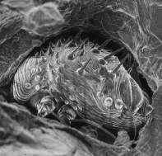
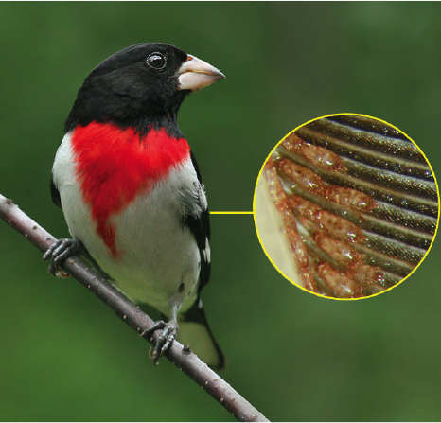
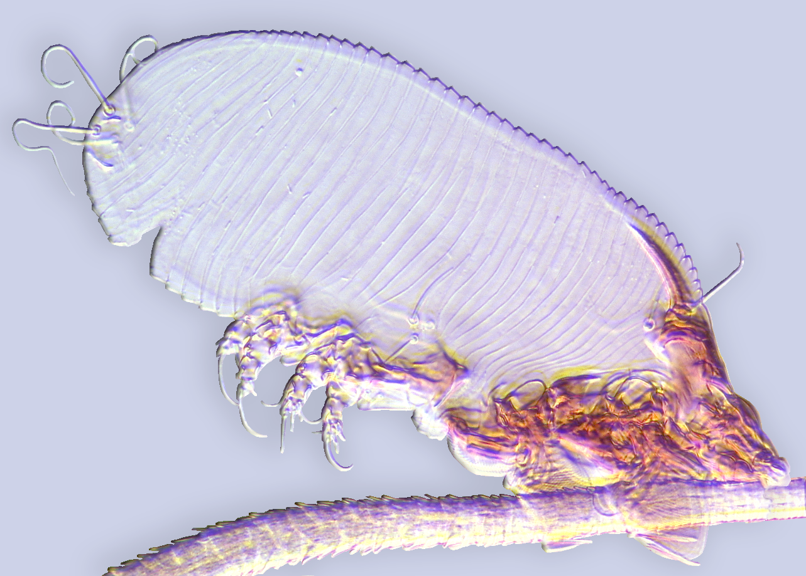
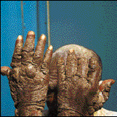
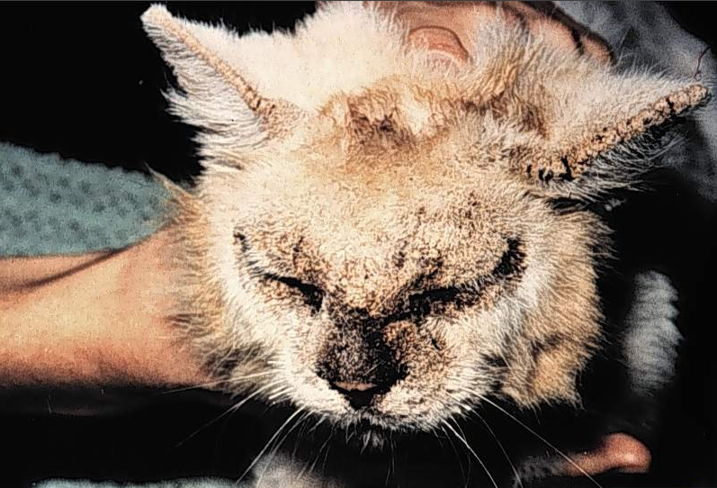
Astigmatid Mites of
Medical-Veterinary Interest-II
Barry M. OConnor & Pavel Klimov
Museum of Zoology & Department of Ecology
& Evolutionary Biology University of Michigan
Ann Arbor, MI 48109

Slide 2
Psoroptidia, phylogenetic placement
Astigmata (6,100 described species) contains an ensemble of several mutually paraphyletic, mostly free-living lineages (‘free-living Astigmata’) and a large monophyletic parasitic lineage – Psoroptidia. Permanent parasitism of vertebrates is the ancestral ecology Psoroptidia.
2,300 spp
3,800 spp (62.3 %)
free-living 1*
free-living 2*
parasitic (Psoroptidia) + house dust mites
Astigmata (6,100 spp)

Slide 3
parasitic as
deutonymphs
Psoroptidia
(parasitic)
Astigmata

Slide 4
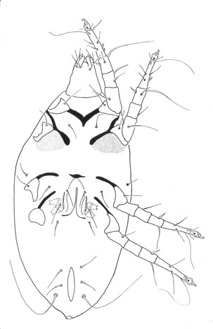
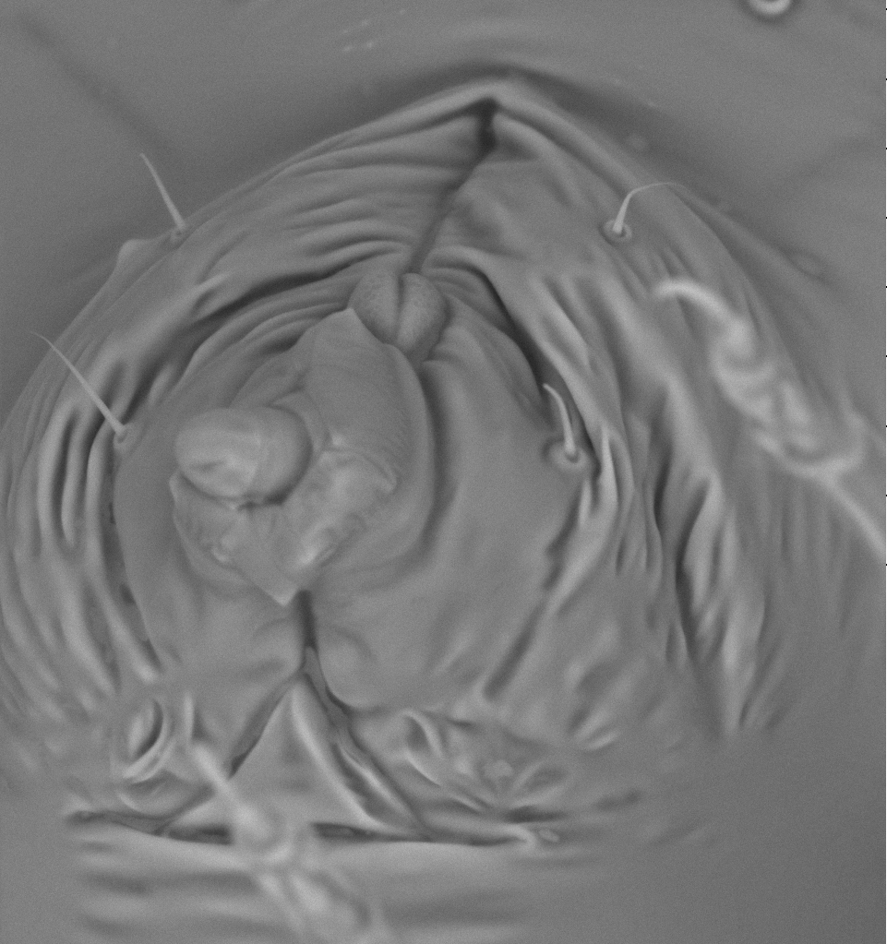
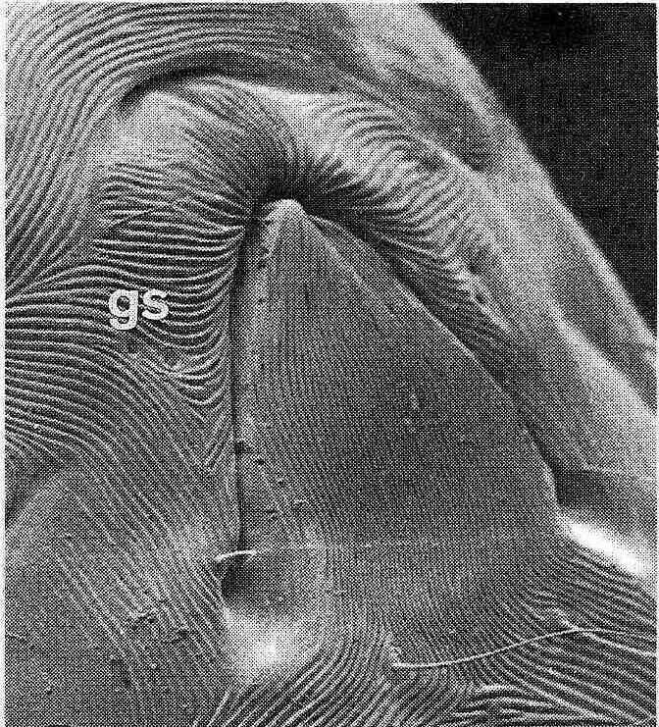
Characteristics of the Psoroptidia
Genital papillae larger, digitiform, situated in internal progenital chamber
Genital papillae reduced, open outside
Cuticle
usually striate
2. Genital
papillae
reduced
oviporus
Genital papillae
oviporus
genital papillae
genital papilla
(1 everted, 3 others not visible)
Non-psoroptidian Astigmata
Chaetodactylus
Psoroptidia
Dermatophagoides
Cuticle usually striate

Slide 5
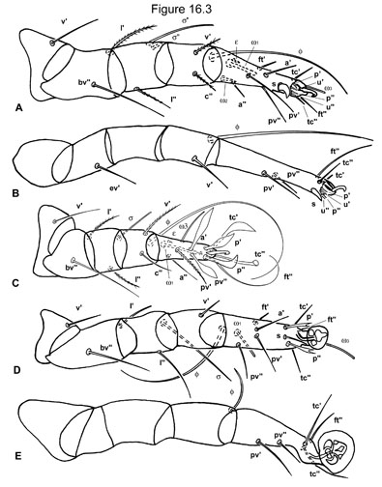
Characteristics of the
Psoroptidia
3. Tibial seta c" I-II lost
4. Unguinal setae (u) of
tarsi lost
5. Proral setae (p) of
tarsi expanded
(Pterolichoidea) or lost
(others)
6. Pretarsal ambulacral
disk often large
7. Empodial claw often
incorporated into disk
claw
membranous ambulacrum
no u’
p'
p''
no c’’
no u’’
ambulacral disk often large
claw often
incorporated into disk

Slide 6
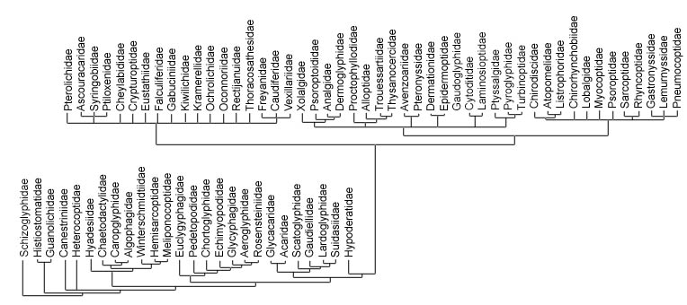
Classification of the Psoroptidia
Sarcoptoidea
(mammals)
Pterolichoidea (birds)
Analgoidea (birds)
The “Psoroptidia”
Unplaced: Lemanniellidae
Notes:
6

Slide 7
superfam. Pterolichoidea (mostly parasites non-passerine birds)
superfam. Analgoidea s.lat.(parasites of passerine birds and mammals)+house dust mites
Psoroptidia
Pterolichoidea
Analgoidea
house dust mites
Psoroptidia
(mostly parasitic taxa)

Slide 8
Obligatory permanent parasites Astigmata
Symbiosis
Parasitism (dependent organism is harmful to host)
Commensalism (dependent organism neither harmful or beneficial to host)
Mutualism (dependent organism is beneficial to host)
What is parasitism?
Describes interactions where the dependent organism (a parasite) is harmful to its hosts.
This classical definition, may be difficult to apply to all mite-host interactions. For example, feather mites are in the ‘grey zone’ because mostly (but not always) the harm is negligible. For these interactions, a more general term, symbiosis, can be used.

Slide 9
Obligatory permanent parasites Astigmata
Type of parasitism: host as food source
Obligatory parasites = feed on host tissues, but not other food sources.
Facultative parasites = can be both parasites and non parasites. For example, a mite feeds on host blood but also can be an opportunistic predator.
Free-living = non parasites.

Slide 10
Obligatory permanent parasites Astigmata
Type of parasitism: host as habitat
Permanent parasites = live only on host, cannot live nowhere else. A free-living dispersal stage is usually lacking. Mites are transferred to hosts via vertical transmission of during mating.
Temporary parasites = live on host (typically during feeding) and off host (the remainder of the life cycle).

Slide 11
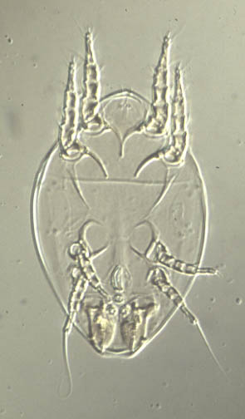
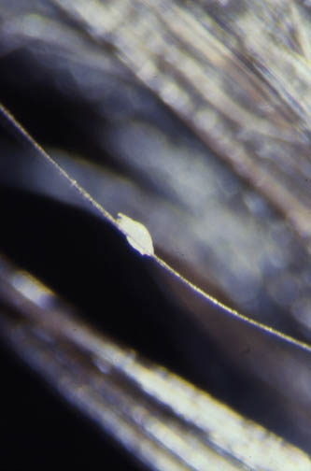
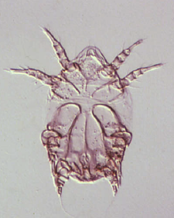
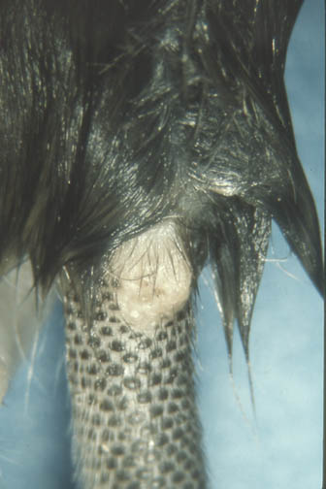
Glycyphagidae
Deutonymphal morphology highly variable
Mammal phoretic on hair
(Glycyphaginae)
Mammal parasitic (endofollicular)
Ctenoglyphinae

Slide 12
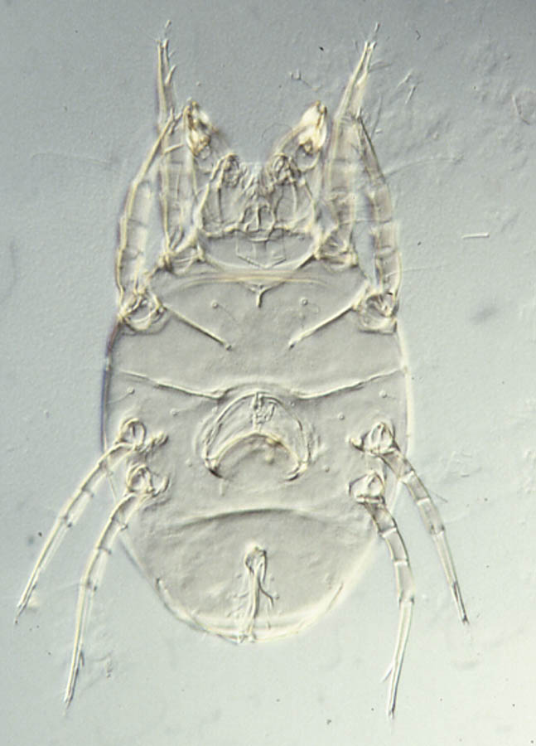
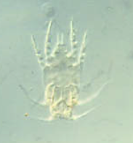
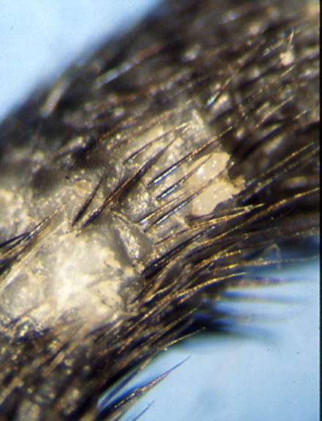
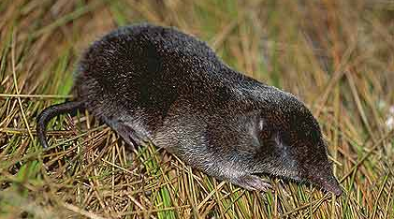
Family Chortoglyphidae
Adults are free-living
Deutonymphs are parasitic
Alabidopus n. sp.
Chortoglyphus
arcuatus

Slide 13
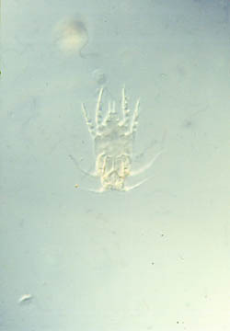
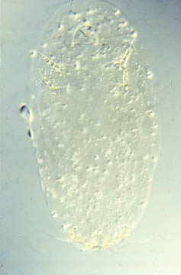
Unusual “feeding” by deutonymphs
not engorged
engorged
Alabidopus n. sp. deutonymph (Chortoglyphidae)

Slide 14
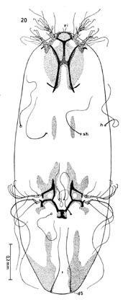
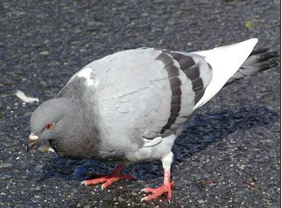
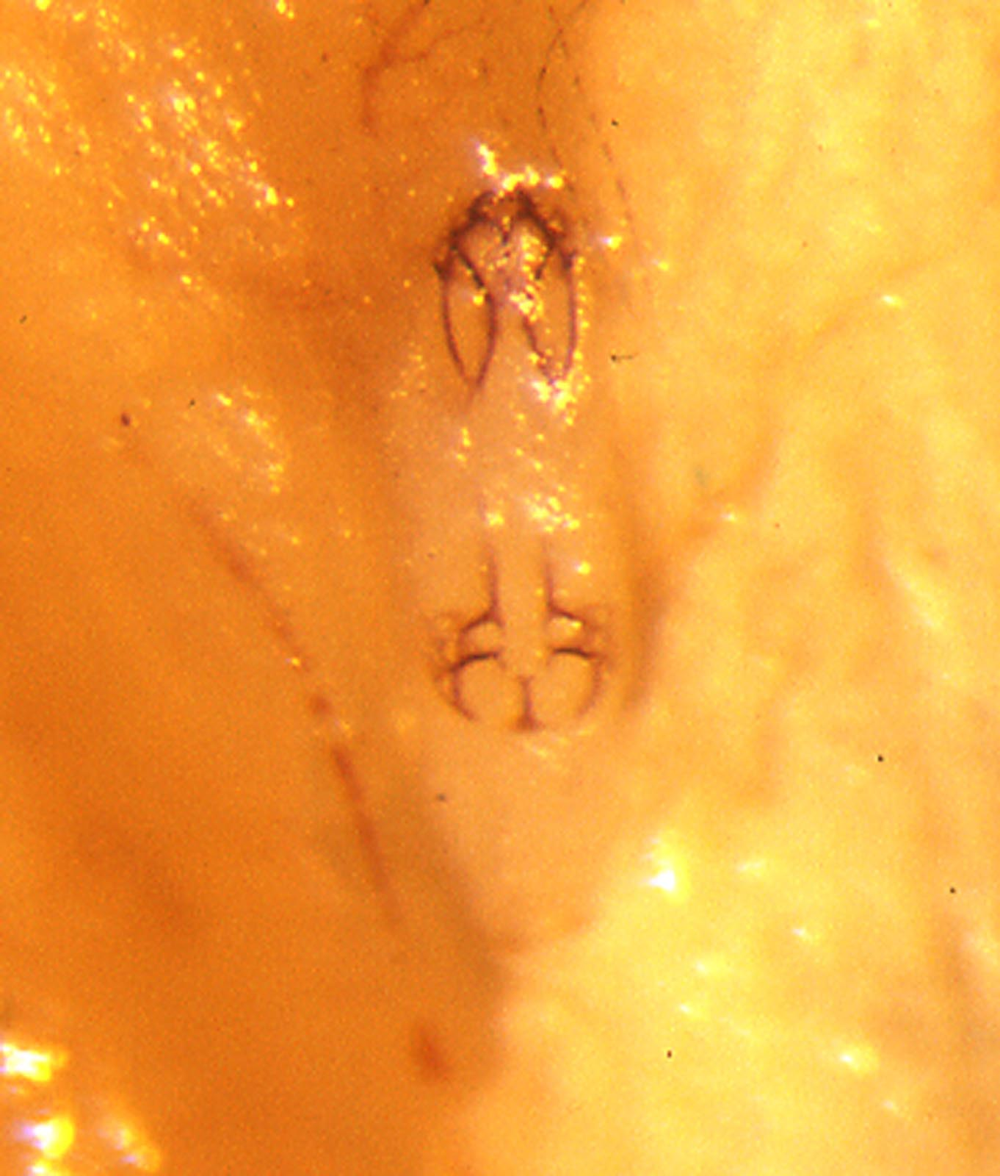
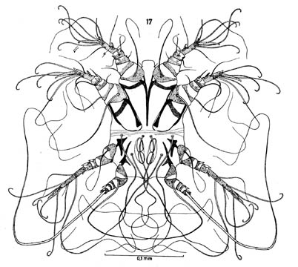
Unusual “feeding” by deutonymphs
Hypodectes propus
ex Columba livia
not engorged
engorged

Slide 15
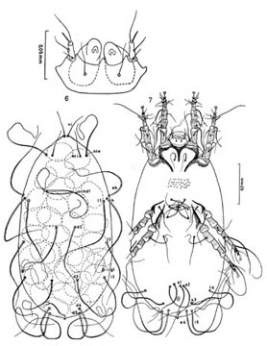
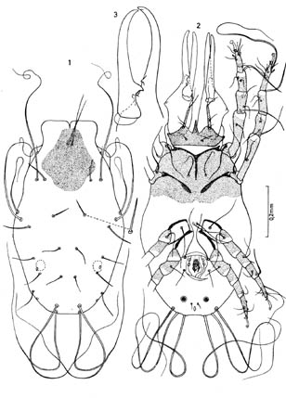
Adults are non-feeding
Hypodectes propus
ex Columba livia
Adult female
Adult male

Slide 16
Microhabitats of Psoroptidia
habitat | birds | mammals
on skin | x | x
in skin or hair/feather follicles | x | x
on hair |  | x
respiratory tract | x | x
stomach |  | x
feather vanes | x
downy feathers | x
feather quills | x

Slide 17
Classification of the Psoroptidia (1 of 2)
Molecular data supports monophyly of Pterolichoidea.
But family Pterolichidae is paraphyletic
Notes:
17

Slide 18
Classification of the Psoroptidia (2 of 2)
Mammal mites
Sarcoptoid taxa cluster in with 3 different Analgoid lineages, suggesting multiple host
shifts from bird to mammal
Notes:
18

Slide 19
The Psoroptidian parasites of mammals
Old superfamily Sarcoptoidea (=Psoroptoidea) characterized by
only 1 derived morphological character: loss of 1 solenidion
from genu I.
Newer phylogeny places most “sarcoptoids” within the bird-
associated Analgoid lineage, with 2 families within the
Epidermoptid-Psoroptid lineage.
We will treat these groups from an ecological
perspective:
Parasites living on skin
Parasites living in skin or hair follicles
Parasites living on hair
Endoparasites in respiratory tract
Notes:
19

Slide 20
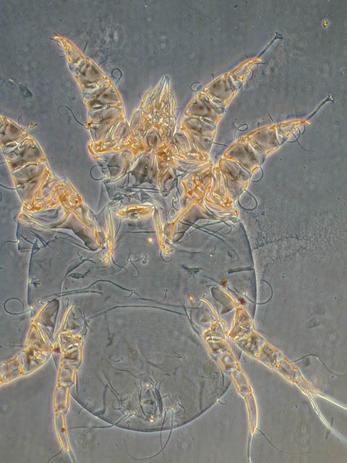
Parasites living on skin
Family Psoroptidae
-Closely related to bird mites
in family Psoroptoididae
and house dust mites
(Pyroglyphidae).
-Characteristics:
Rounded idiosoma
Female ovipore an
inverted U
Host associations:
Artiodactyla, Perrisodactyla
Hyracoidea, Primates,
Xenarthra, Rodentia,
Insectivora, Marsupials.
ovipore an inverted U
Psoroptes ovis
Notes:
20

Slide 21
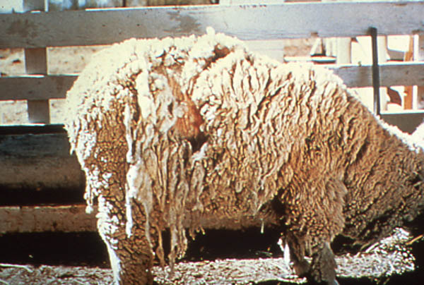
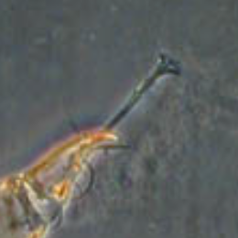
Parasites living on skin
Family Psoroptidae
Important taxa
Psoroptes - ambulacral stalks
I-II elongate, "annulated"
Female without pretarsus III
Psoroptes ovis
(=P. equi, P. cunniculi, etc.)
Pests on skin of horses, sheep,
goats; also invade ears of horses,
rabbits
Psoroptes ovis
female without pretarsus III
ambulacral stalks I-II elongate, "annulated"
Notes:
21

Slide 22
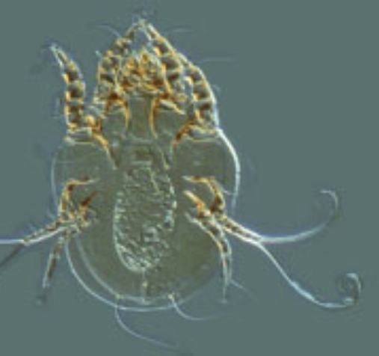
ambulacral stalks short
Parasites living on skin
Family Psoroptidae
Important taxa
b. Chorioptes - similar to Psoroptes
but ambulacral stalks short
Chorioptes bovis
(barn itch mite of cattle,
occasionally other hosts)
Pests on skin especially when
cattle confined in barns; free-range
cattle not typically bothered.
Other species on reindeer, African buffalo, duiker, Japanese
serow, giant panda
Notes:
22

Slide 23
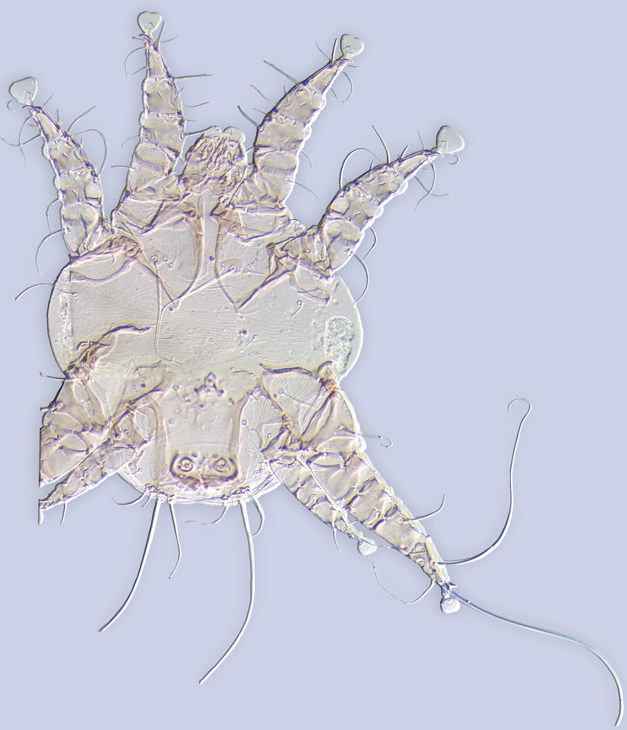
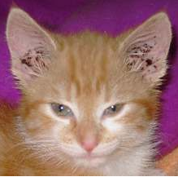
Parasites living on skin
Family Psoroptidae
Important taxa
c. Otodectes - female without
pretarsus IV; male with 2
long setae on tarsus III
1 species: Otodectes cynotis
(carnivore ear mite)
Pests in ears of domestic and
wild carnivores (dog, cat, ferret &wild felids, canids & mustelids)
male with 2 long setae on tarsus III
Otodectes cynotis (Psoroptidae)
Notes:
23

Slide 24
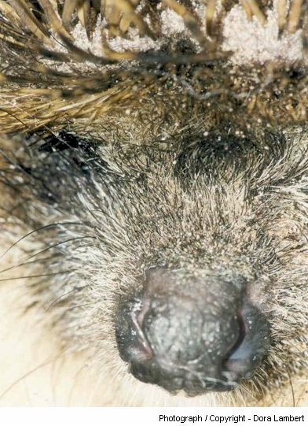
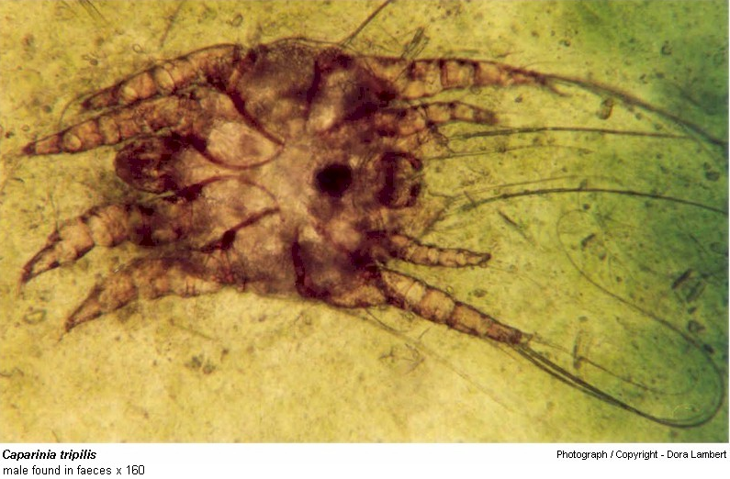
Parasites living on skin
Family Psoroptidae
Important taxa
d. Caparinia species on
hedgehogs - problems in pet
trade
Caparinia tripilis
Notes:
24

Slide 25
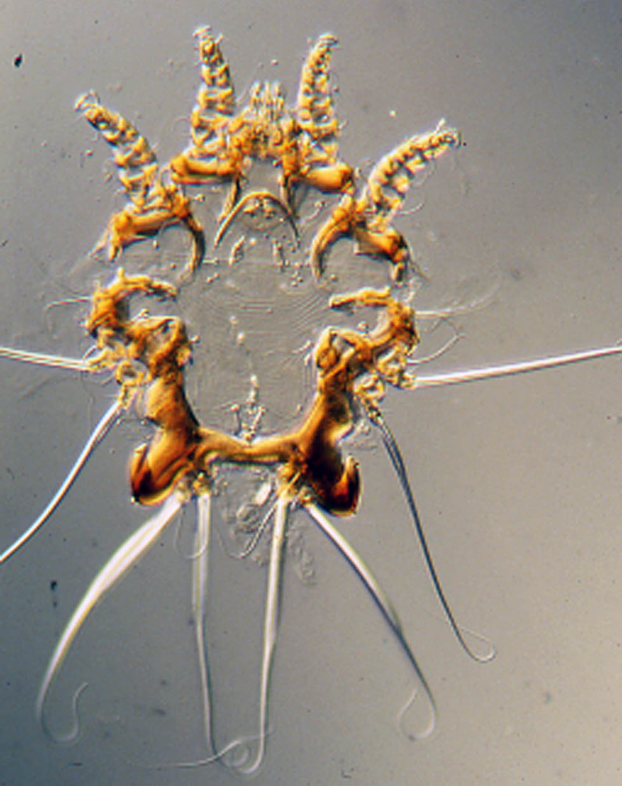
Parasites living on skin
Family Psoroptidae
Important taxa
e. 15 genera on non-human
Primates - all groups affected
except humans & tarsiers
Fonsecalges samirii
Notes:
25

Slide 26
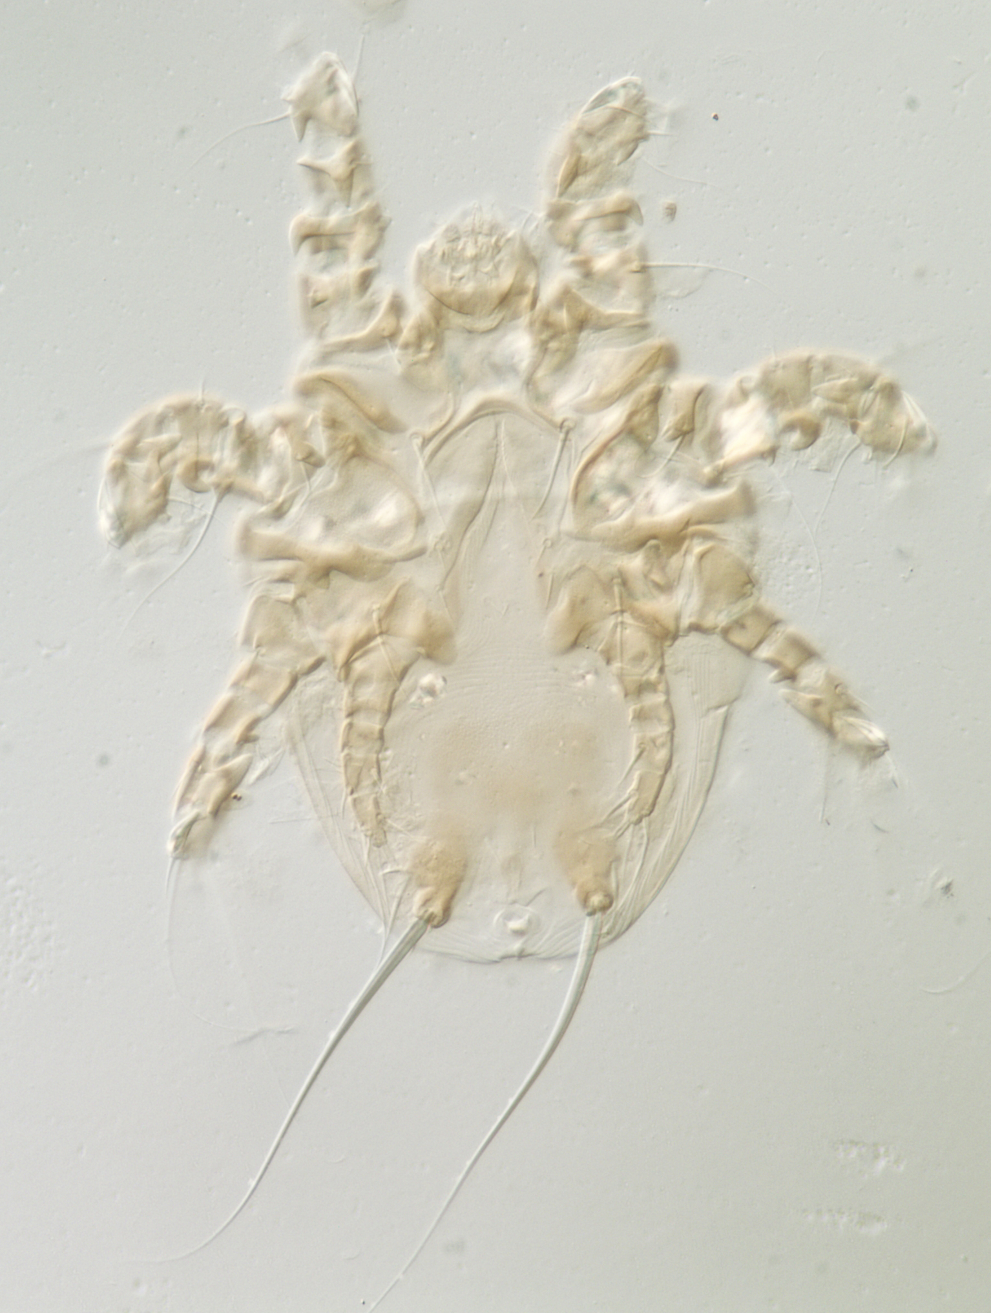
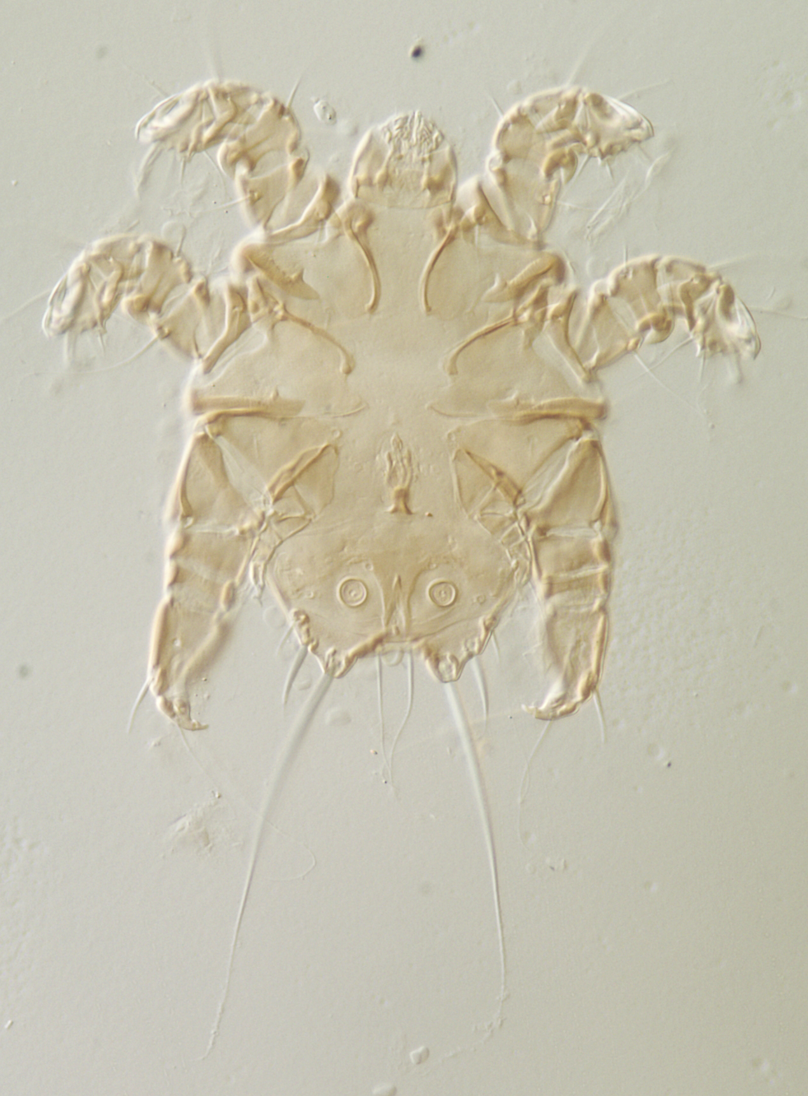
Parasites living on skin
2. Family Listropsoralgidae
Formerly included in Psoroptidae
4 genera, 13 species
Hosts: marsupials (S. America
& Australia; 1 species on a spiny
rat (Echimyidae), S. America)
Listropsoralges faini
Bochkov & Wauthy, 2009
ex Marmosa regina
Notes:
26

Slide 27
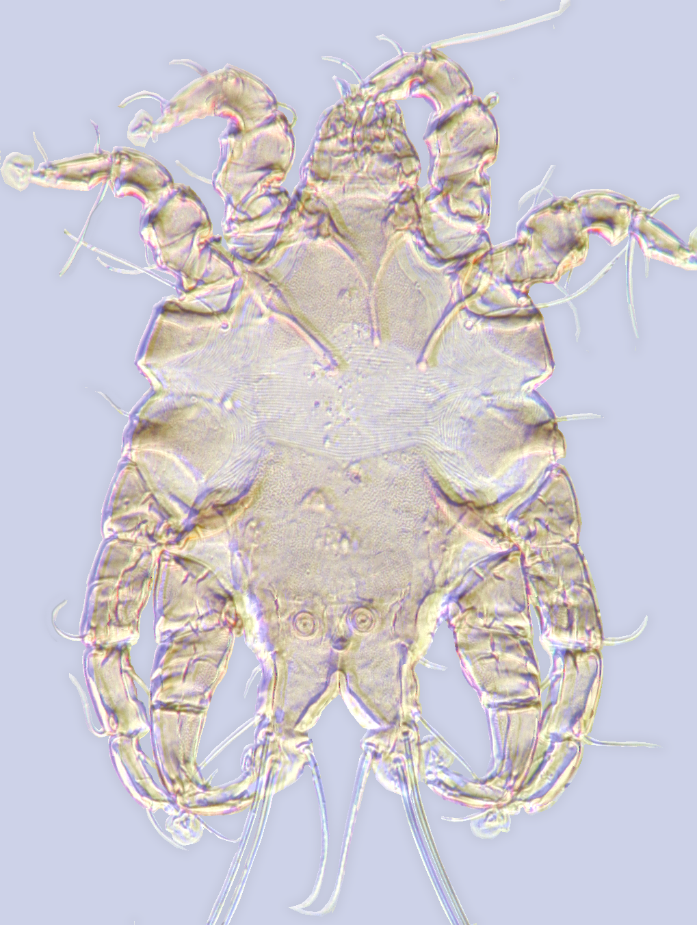
xxxx
Lobalges trouessarti (Lobalgidae)
Other mites associated with mammals live on skin and feed by scraping the skin with their chelicerae and ingesting tissue fluid (e. g. Psoroptidae). The feeding habits of Lobalgidae are unknown, but its species were collected from fur of sloths and spiny hairs of echimyid rodents.

Slide 28
Classification of the Psoroptidia (2 of 2)
Mammal mites
Sarcoptoid taxa cluster in with 3 different Analgoid lineages, suggesting multiple host
shifts from bird to mammal
Notes:
28

Slide 29
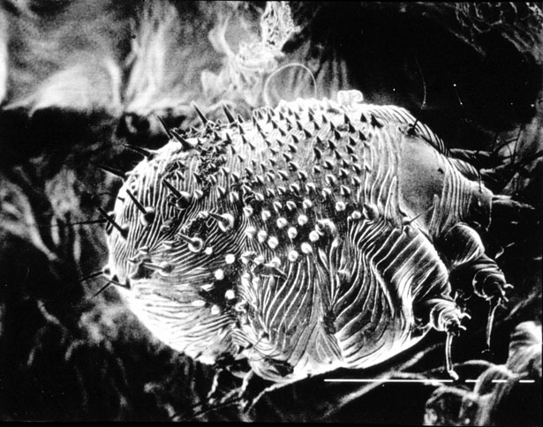
Parasites living in skin
Family Sarcoptidae
Characteristics:
Body rounded, occasionally
elongated dorsoventrally;
female w/o hysterosomal
sclerotization - present in most
males; dorsal setae sometimes
spine-like; female ovipore
usually transverse (inverted V
in marsupial parasites); anus
terminal or dorsal. Legs short!
Sarcoptes scabiei
Notes:
29

Slide 30
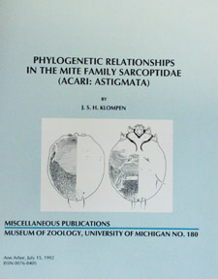
Parasites living in skin
Family Sarcoptidae
Host associations:
a. Subfamily Diabolicoptinae
with 3 early derivative genera
on Australian marsupials.
b. Subfamily Sarcoptinae with
1 genus on rodents, 3 on primates
(Sarcoptes secondarily on other
host groups)
c. Subfamily Teinocoptinae with
9 genera on bats (Notoedres with
secondary host shifts onto
rodents & small carnivores.
Notes:
30

Slide 31
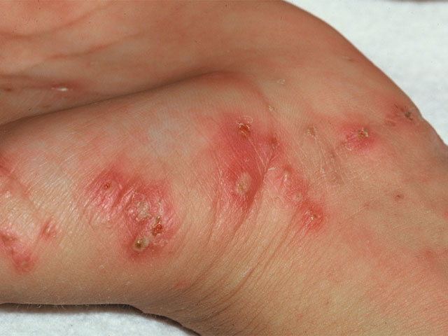
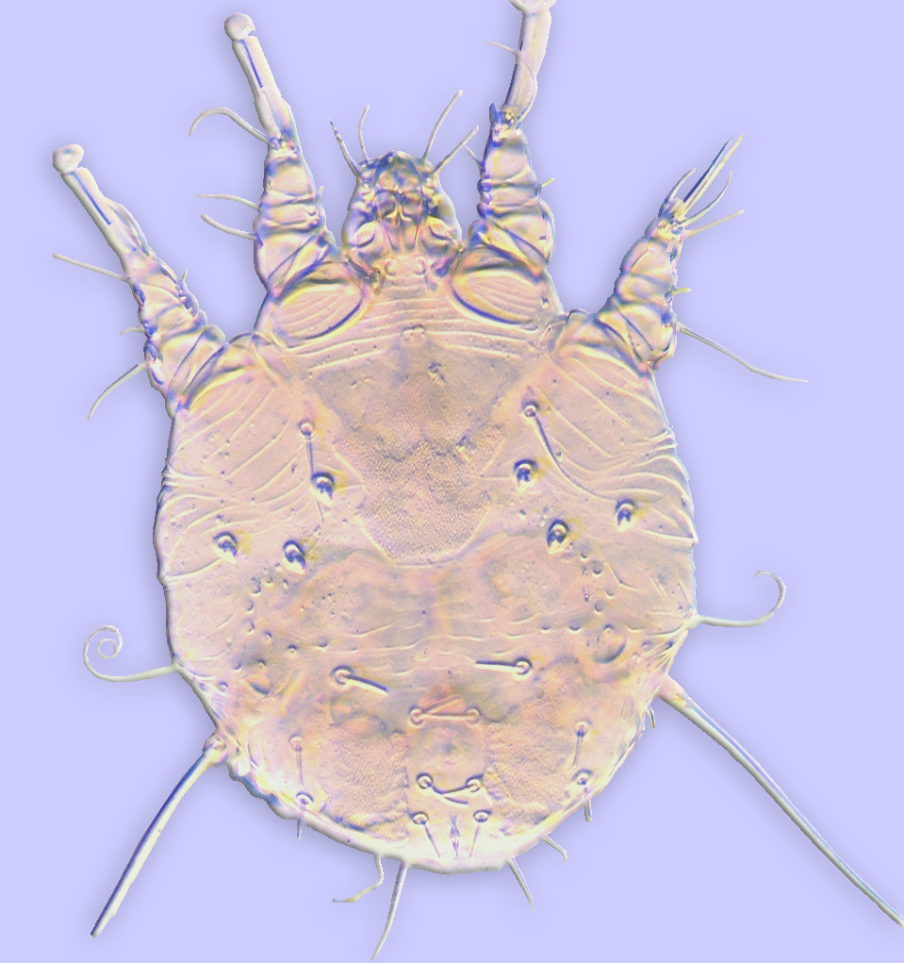
Parasites living in skin
Family Sarcoptidae
Important taxa
a. Sarcoptes scabiei
An old human parasite
causing “scabies”
Sarcoptes scabiei (Sarcoptidae)

Slide 32
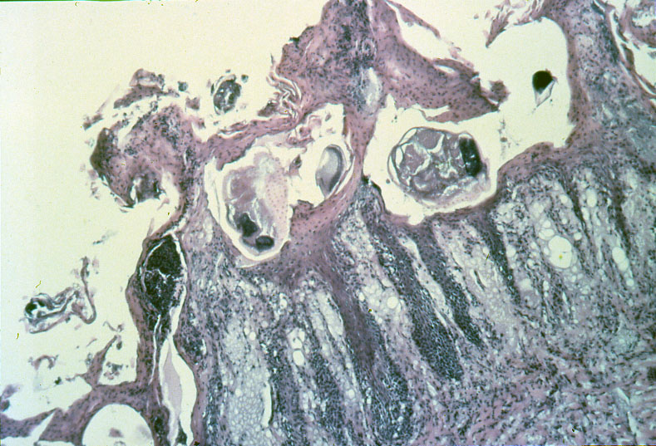
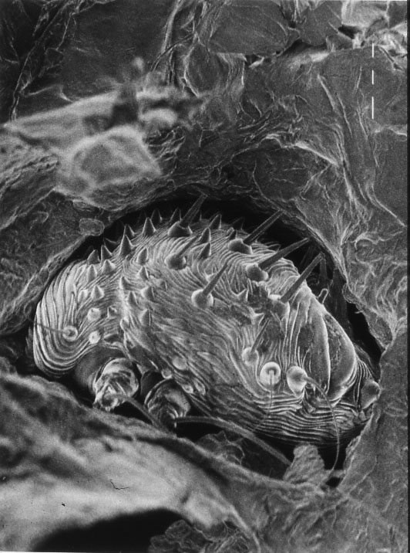
Parasites living in skin
Family Sarcoptidae
Important taxa
Sarcoptes scabiei
Mites burrow laterally
in skin. Spine-like dorsal
setae and cuticular projections
aid in burrowing.
Sarcoptes

Slide 33
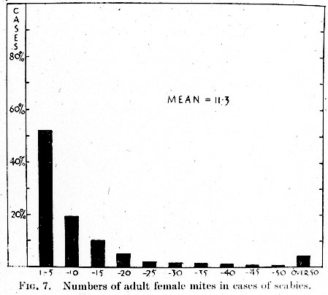
Parasites living in skin
Family Sarcoptidae
Important taxa
Sarcoptes scabiei
Normal scabies infestations
typically contain few mites
are self-limiting and confer
immunity.

Slide 34
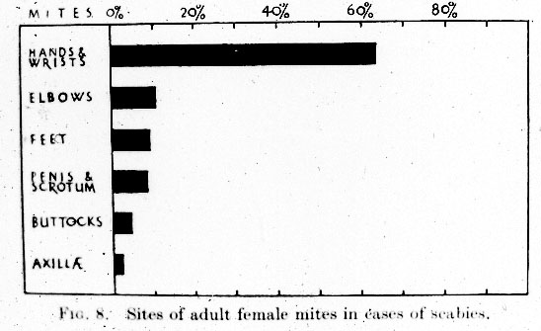
Parasites living in skin
Family Sarcoptidae
Important taxa
Sarcoptes scabiei
Mites are typically
confined to the extremities.
Adult females disperse via
direct contact between
people but can live off the
host for ~24 hours.

Slide 35
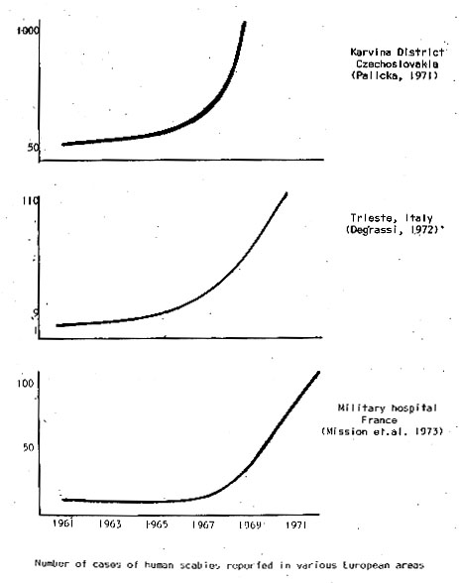
Parasites living in skin
Family Sarcoptidae
Important taxa
Sarcoptes scabiei
Normal scabies may occur
in epidemics when enough
people are susceptible.
Data from a scabies epidemic
in Europe in the late 1960’s

Slide 36
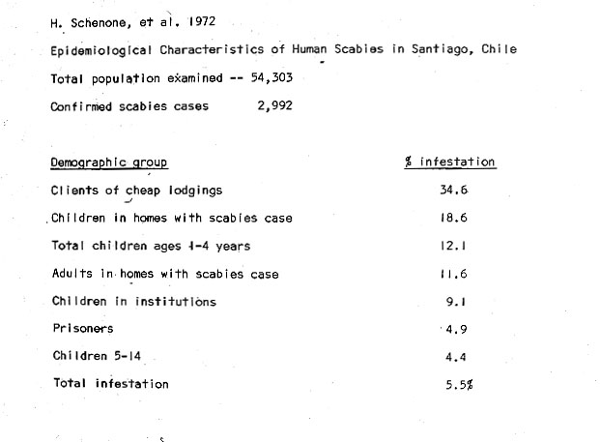
Parasites living in skin
Family Sarcoptidae Important taxa Sarcoptes scabiei
All humans are susceptible, but transmission more
likely in crowded conditions.

Slide 37
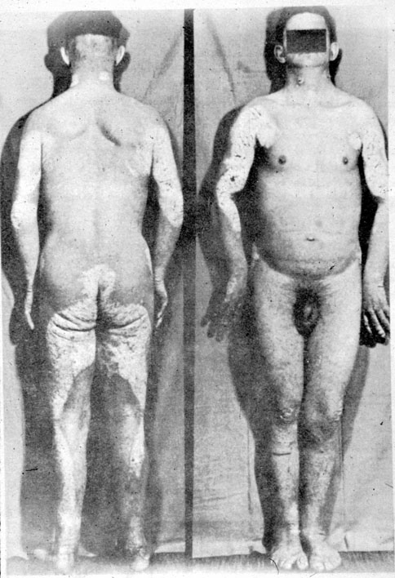
Parasites living in skin
Family Sarcoptidae
Important taxa
Sarcoptes scabiei
The condition called
crusted scabies,
where millions of mites
may be present is
related to immune
deficiency (old age,
transplant patients,
HIV/AIDS patients).
scabies
crusted scabies

Slide 38
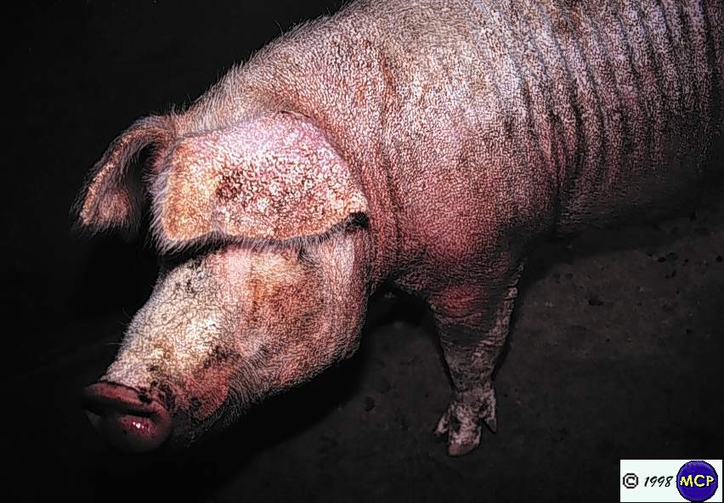

Parasites living in skin
Family Sarcoptidae
Important taxa
Sarcoptes scabiei
has colonized many domestic
and wild mammals where it
causes “sarcoptic mange”,
a condition similar to crusted
scabies in humans with
thickened skin, hair loss &
secondary bacterial infections.
Sarcoptic mange
Notes:
38

Slide 39

Parasites living in skin
Family Sarcoptidae
Important taxa
Sarcoptic mange has spread
into many wild canid populations
where it causes severe mortality.
it is also a major problem in
Australian wombats.
Sarcoptic mange in red wolf and coyote.
Notes:
39

Slide 40



Parasites living in skin
Family Sarcoptidae
d. Most sarcoptids on bats
are not pathogenic
mite partially embedded in host skin
Teinocoptes on Pteropodidae.
mite female
mites
mite eggs
bat wing membrane
Notoedres philippinensis on
Vespertilionidae.
Chirnyssoides on Phyllostomidae
bat wing membrane
Notes:
40

Slide 41

Parasites living in skin
Family Sarcoptidae
Important taxa
b. Notoedres species
Most species of Notoedres
occur on bats, but one
small lineage has host-
shifted onto rodents and
small carnivores.
Notoedres cati
Parasitizes Felidae and
Viverridae, also on rabbits.
N. cati female
dorsum
Notes:
41

Slide 42

Parasites living in skin
Family Sarcoptidae
Important taxa
b. Notoedres species
2) N. muris on muroid
rodents (Holarctic)
3) N. oudemansi on
rats, hedgehogs (Africa)
4) N. pseudomuris on
house mice (Asia)
5) N. pahangi on rats
(Asia, Africa)
N. muris vertical burrows in rat skin.
Notes:
42

Slide 43



Parasites living in skin
Family Sarcoptidae
Important taxa
b. Notoedres species
6) N. centrifera on
squirrels, chipmunks &
porcupines (Nearctic
? Asia)
mite eggs
N. centrifera burrow.
N. centrifera lesion mounted on slide.
Notes:
43

Slide 44

Parasites living in skin
Family Sarcoptidae
Important taxa
c. Trixacarus species
T. diversus occurs on
commensal rats (and can
cause damage in lab colonies).
T. caviae parasitizes guinea pigs
and causes a mange condition.
guinea pig infested with Trixacarus caviae
Notes:
44

Slide 45


Parasites living in skin
2. Family Rhyncoptidae
Species of Rhyncoptidae
inhabit the hair follicles of
shrew opossums (Caenolestidae),
primates, African porcupines,
bears & raccoons. Only species of
Ursicoptes on bears
and raccoons are
known to be
pathogenic.
Saimirioptes hershkovitzi
from monkey.
Rhyncoptes
from monkey.
Notes:
45

Slide 46
Classification of the Psoroptidia (2 of 2)
Mammal mites
Sarcoptoid taxa cluster in with 3 different Analgoid lineages, suggesting multiple host
shifts from bird to mammal
Notes:
46

Slide 47



Now am going to introduce you to some groups of Psoroptidia.
Labidocarpellus eonycteris
(Chirodiscidae)
Chirodiscoides interruptus
(Atopomelidae)
Listrophorus squamiferus
(Listrophoridae)
Fur mites (families Listrophoridae, Atopomelidae, and Chirodiscidae) are presumably monophyletic, specialized for life on hair shafts feeding on sebaceous materials and generally causing no damage to the hair.

Slide 48


striated clasping
membranes arising from coxal fields I
Parasites living on hair (fur mites)
1. Family Listrophoridae
Species of Listrophoridae
inhabit the hair shafts of rodents,
insectivores, small carnivores,
lagomorphs, and one shrew
opossum (!).
They are characterized by a
projecting tectum covering the
gnathosoma and striated clasping
membranes arising from coxal
fields I and sometimes II.
The family occurs worldwide
except not in Australia or
on native mammals in Madagascar.
tectum covering the gnathosoma
Listrophorus pitymys from vole.
Prolistrophorus bakeri from cotton rat.
Listrophorus squamiferus
(Listrophoridae)
Notes:
48

Slide 49


Parasites living on hair (fur mites)
1. Family Listrophoridae
Most listrophorids are cylindrical
or laterally compressed. A. borealis
is dorso-ventrally flattened.
L.caudatus has a
posterior projection in the female that is NOT an intromittent organ!
Aplodontochirus borealis
from mountain beaver.
Listrophorus caudatus
from Florida muskrat.
Notes:
49

Slide 50

Parasites living on hair (fur mites)
1. Family Listrophoridae
Synhospitaly is known in the
genus Listrophorus, with muskrats
(Ondatra) having 6 species, and
Florida muskrats (Neofiber) having 3.
Ondatra zibethicus &
Neofiber alleni
Notes:
50

Slide 51
Parasites living on hair (fur mites)
1. Family Listrophoridae
Species occurring on domestic or laboratory animals include:
Afrolistrophorus musculus on house mouse
A. maculatus on Rattus spp.
Lynxacarus radovskyi on cats
Leporacarus gibbus on European rabbit
None are known to be pathogenic.
Notes:
51

Slide 52


Parasites living on hair (fur mites)
2. Family Atopomelidae
Inhabit the hair shafts of rodents,
insectivores, primates,
elephant shrews and tenrecs.
They are very diverse on
marsupials as well.
They are most prevalent in the
Southern hemisphere & the
Asian tropics.
Atopomelus locusta from gymnure.
Atopomelus crocidurae from shrew.
Notes:
52

Slide 53
Parasites living on hair (fur mites)
2. Family Atopomelidae
Diagnostics
Fusion of tibia-tarsus III-IV.
Legs I-II clasp the host hair.
legs I-II clasp host hair
tibia and tarsus of legs III-IV fused
Notes:
53

Slide 54


Parasites living on hair (fur mites)
2. Family Atopomelidae
Populations may sometimes
reach very high densities but
appear to do no damage.
Extreme synhospitaly occurs on
Asian spiny rats (Maxomys spp.)
Where over 20 species occur on
2 host species.
Synhospitaly is also the rule in
Madagascar where most rodents
harbor up to 6 species and tenrecs
and lemurs up to 3.
The potoroo of Australia harbors
21 species of Cytostethum!
Alistrophoroides sp. from shrew tenrec.
Didelphoecius sp. from mouse opossum.
Notes:
54

Slide 55

Parasites living on hair (fur mites)
2. Family Atopomelidae
Chirodiscoides caviae is common
on guinea pigs. Some damage is
reported, but may have other causes.
Listrophoroides cucullatus is found
on commensal rats in tropical areas.
Chirodiscoides caviae from gunea pig
Notes:
55

Slide 56


Parasites living on hair (fur mites)
3. Family Chirodiscidae
Species of Chirodiscidae
are most diverse on bat hosts,
others occur on African shrews,
golden moles, a lemur, and on
beavers.
Labidocarpellus sp. from fruit bat.
Schizocoptes conjugatus
from golden mole.
Notes:
56

Slide 57

Parasites living on hair (fur mites)
3. Family Chirodiscidae
The family is characterized by the
extreme flattening of the anterior
tarsi in all taxa, the total modification
of legs I-II in most, and the reduction
of the legs in the nymphal females.
tarsi I-II extremely flattened
Labidocarpellus eonycteris
(Chirodiscidae)
Notes:
57

Slide 58


Pre-copulatory guarding is taken to the extreme in the
family Chirodiscidae, fur mites of mammals
legs reduced in the nymphal females
Alabidocarpus vietnamensis
ex Rhinolophus inops,
Philippines

Slide 59


Parasites living on hair (fur mites)
3. Family Chirodiscidae
Chirodiscid mites are often very
abundant on their hosts.
Extreme synhospitaly occurs in
the genus Schizocarpus, with 51
species living on the 2 extant species
of beavers!
mites
Soricilichus sp. from African shrew.
Schizocarpus numerosus
from European beaver.
Notes:
59

Slide 60
Classification of the Psoroptidia (2 of 2)
Mammal mites
Notes:
60

Slide 61


Parasites living on hair (fur mites)
4. Family Myocoptidae
Myocoptid mites have legs III-IV
of females & juveniles and legs
III of males modified for hair-
clasping. Unlike true fur-mites,
they feed from the skin at the
base of the hair.
The family is worldwide on
rodents and on marsupials in
South America and Australia.
legs III-IV of females modified for hair-
clasping
Myocoptes lepidotus
from mouse.
legs III of males modified for hair-
clasping
Myocoptes japonensis (Myocoptidae)
Notes:
61

Slide 62


Parasites living on hair (fur mites)
4. Family Myocoptidae
Important species:
Myocoptes musculinus on
house mice and other rodents
b) Trichoecius romboutsi on
house mice.
Both can cause hair loss and
“mange” in lab mice.
Myocoptes japonensis from vole.
Trichoecius gettingeri
from white footed mouse.
Notes:
62

Slide 63
Classification of the Psoroptidia (2 of 2)
Mammal mites
Sarcoptoid taxa cluster in with 3 different Analgoid lineages, suggesting multiple host
shifts from bird to mammal
Notes:
63

Slide 64

Parasites living as
endoparasites
Family Gastronyssidae
Parasites of bats & rodents.
most taxa in upper respiratory
tract.
Genus Gastronyssus in stomach
of Pteropodidae.
Some Opsonyssus in eye orbits
of Pteropodidae.
Sciuracarus from African squirrel.
Mycteronyssus polli
Notes:
64

Slide 65

Mammal-associated Analgoidea living as endoparasites
Yunkeracarus (Gastronyssidae)
Yunkeracarus in muroid rodents
Notes:
65

Slide 66


Parasites living as
endoparasites
2. Family Pneumocoptidae
1 genus, Pneumocoptes
with 5 species in lungs of rodents:
voles, mice, squirrels
Pneumocoptes penrosei
Notes:
66

Slide 67

Parasites living as
endoparasites
3. Family Lemurnyssidae
2 genera, 3 species in nasal
passages of Primates
(bushbabies & squirrel
monkeys)
Notes:
67

